Slide 1
Basics of RFID Technology

Slide 2
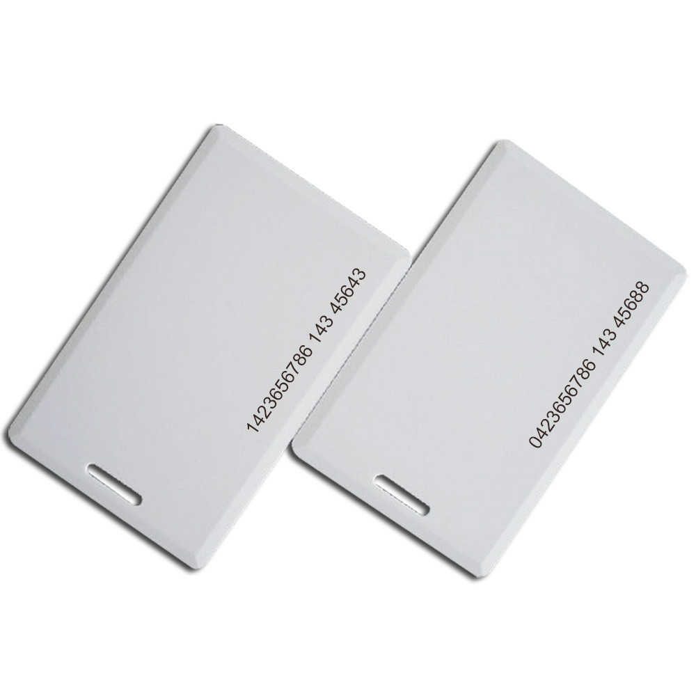
RFID CARDS

Slide 3
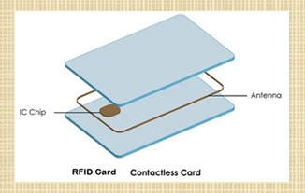
RFID CARD

Slide 4
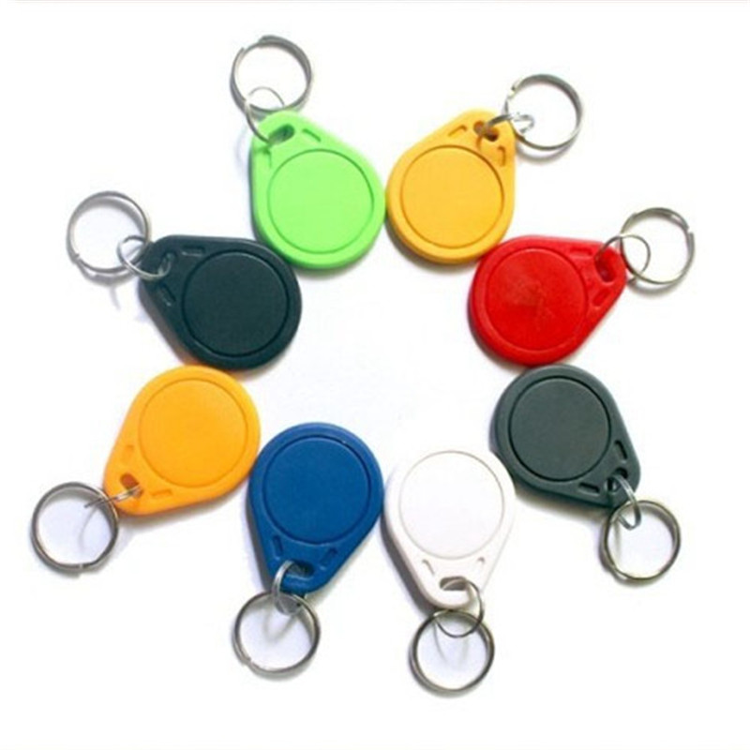
RFID KEY CHAINS

Slide 5
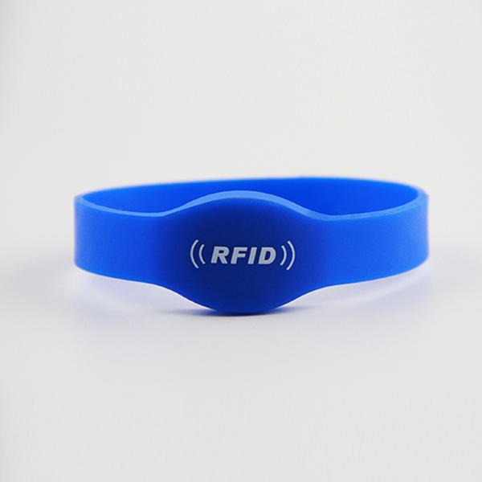
RFID WRIST BAND

Slide 6
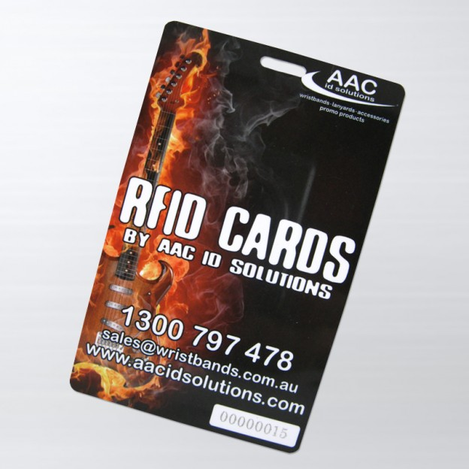
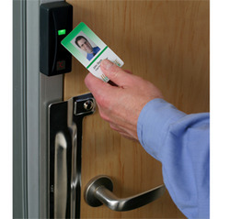
RFID REAL TIME USAGE

Slide 7
Session Description
How to determine which technology is best for you by asking yourself three little questions:
"How far?”
"How fast?”
"How many?”

Slide 8
What is RFID?
RFID is an ADC technology that uses radio-frequency waves to transfer data between a reader and a movable item to identify, categorize, track...
RFID is fast, reliable, and does not require physical sight or contact between reader/scanner and the tagged item

Slide 9
What Constitutes an RFID System?
One or more RF tags
Two or more antennas
One or more interrogators
One or more host computers
Appropriate software

Slide 10

Components of an RFID System
Host Computer
Host Memory Space
Antenna
Customer-Specific
Application Software
Application
Program
Interface
(API)
Application
Program
Interface
(API)
RFID API Software
(Communicates with the RFID Reader)
Reader

Slide 11
RFID System Components
(block diagram)
Antenna
Reader
Asset/Tag
Asset
Firmware
Tag
Insert
TCP/IP
~
Host
Power
Application
Software
Customer’s
MIS
API
Notes:
To help you understand how tightly integrated RFID applications are to the customer’s environment, we have prepared an analysis of each system component, describing the component and environmental properties and considerations.

Slide 12
RFID Operation
Sequence of Communication
Host Manages Reader(s) and Issues Commands
Reader and tag communicate via RF signal
Carrier signal generated by the reader (upon request from the host application)
Carrier signal sent out through the antennas
Carrier signal hits tag(s)
Tag receives and modifies carrier signal
  “sends back” modulated signal (Passive Backscatter - FCC and ITU refer to as “field disturbance device”)
Antennas receive the modulated signal and send them to the Reader
Reader decodes the data
  Results returned to the host application
Notes:
NOTE: Bullet 5 - Tag is NOT actually generating and transmitting a signal. The Tag modifies the signal and sends it back to the reader.
Intermec tags are “passive tags” because they are NOT generating and transmitting their own signal.

Slide 13
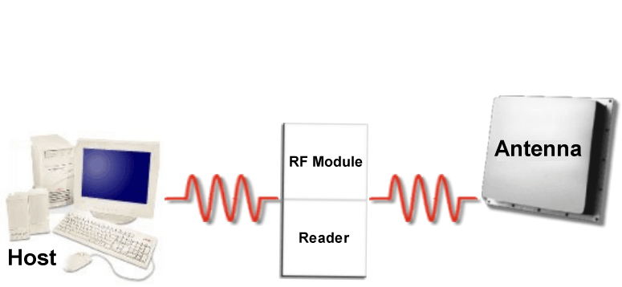
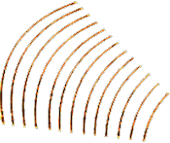

RFID Operations

Slide 14
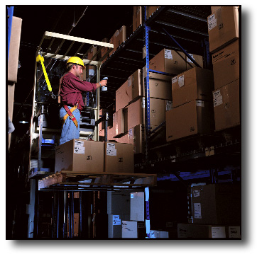
What is RFID? -- The Tags
Tags can be read-only or read-write
Tag memory can be factory or field programmed, partitionable, and optionally permanently locked
Bytes left unlocked can be
rewritten over more than
100,000 times

Slide 15
RFID System Basics
Tag ID Only
Programmable Database Pointer
Mission Critical Information
Portable Database
Read Only (Factory Programmed)
WORM - Write Once, Read Many times
Reprogrammable (Field Programmable)
Read/Write (In-Use Programmable)

Slide 16
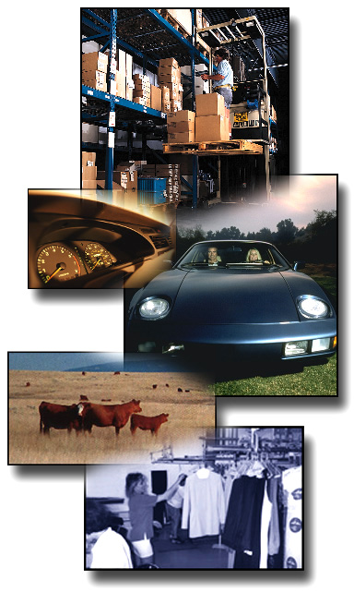
What is RFID? -- The Tags
Tags can be attached to
almost anything:
  pallets or cases of product
  vehicles
  company assets or personnel
  items such as apparel,
  luggage, laundry
  people, livestock, or pets
  high value electronics such
  as computers, TVs, camcorders

Slide 17
Are All Tags The Same?
Basic Types:
  Active
    Tag transmits radio signal
    Battery powered memory, radio & circuitry
    High Read Range (300 feet)
  Passive
    Tag reflects radio signal from reader
    Reader powered
    Shorter Read Range (4 inches - 15 feet)

Slide 18
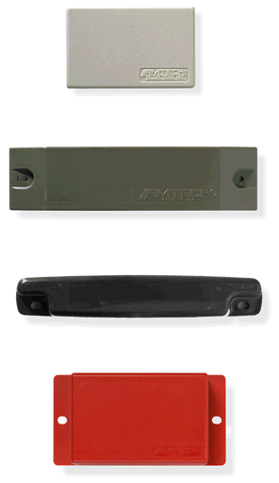
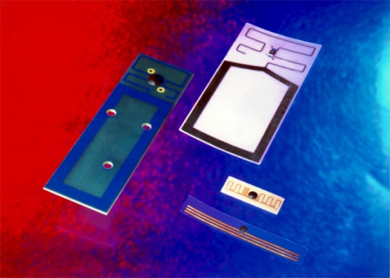
Are All Tags The Same?
Variations:
  Memory
    Size (16 bits - 512 kBytes +)
    Read-Only, Read/Write or WORM
    Type: EEProm, Antifuse, FeRam
  Arbitration (Anti-collision)
    Ability to read/write one or
    many tags at a time
  Frequency
    125KHz - 5.8 GHz
  Physical Dimensions
    Thumbnail to Brick sizes
  Price ($0.50 to $250)

Slide 19
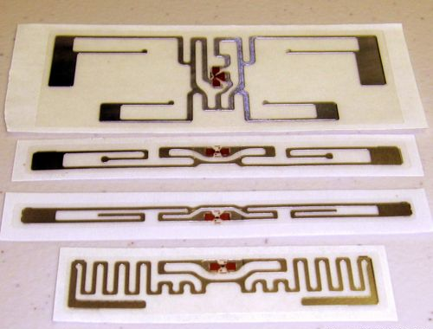
RFID CARD

Slide 20
RFID System Basics
How far?
How fast?
How many?
How much?
Attached to and surround by what?

Slide 21
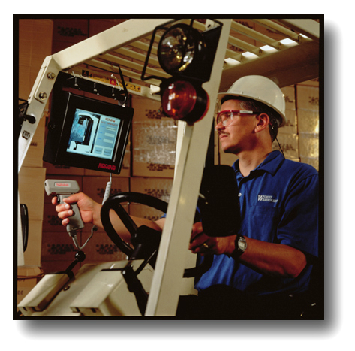
What is RFID? -- The Readers
Readers (interrogators) can be at a fixed point such as
  Entrance/exit
  Point of sale
  Warehouse
Readers can also be
mobile -- tethered,
hand-held, or wireless

Slide 22
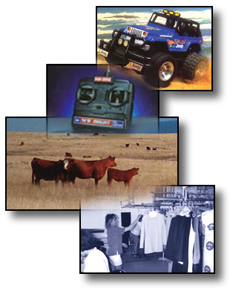
<150 kHz (125 kHz & 134 kHz )
Advantages
Uses normal CMOS processing —
basic and ubiquitous
Relative freedom from
regulatory limitations
Well suited for applications
requiring reading small
amounts of data at slow
speeds and minimal distances
Penetrates materials well
(water, tissue, wood, aluminum)

Slide 23
<150 kHz (125 kHz & 134 kHz )
Disadvantages:
Does not penetrate or transmit around metals
(iron, steel)
Handles only small amounts of data
Slow read speeds
Large Antennas -- compared to higher frequencies
Minimal Range

Slide 24
<150 kHz (125 kHz & 134 kHz )
Disadvantages:
Tag construction:
  is thicker (than 13.56 MHz)
  is more expensive (than 13.56 MHz)
  more complex
  (requires more turns of the induction coil)

Slide 25
13.56 MHz
Advantages
Uses normal CMOS processing--basic and ubiquitous
Well suited for applications requiring reading small amounts of data and minimal distances
Penetrates water/tissue well
Simpler antenna design (fewer turns of the coil); lower costs to build
Higher data rate (than 125 kHz--but slower than higher MHz systems)
Thinner tag construction (than 125 kHz)
Popular Smart Card frequency

Slide 26
13.56 MHz
Disadvantages
Government regulated frequency
(U.S. and Europe recently harmonized)
Does not penetrate or transmit around metals
Large Antennas (compared to higher frequencies)
Larger tag size than higher frequencies
Tag construction: requires more than one surface to complete a circuit
Reading Range of ≈ 0.7 m

Slide 27
RFID Primer…Frequencies
RFID:
Toll Roads
Electromagnetic Field
Coupling: Lower Range UHF
>300 MHz <3 (<1) GHz
(862-928 MHz ANSI MH10.8.4, ISO 18185, B-11 & GTAG)
(433.92 MHz ISO 18185)
Data
Terminal
Cell Phone
1000 MHz

Slide 28
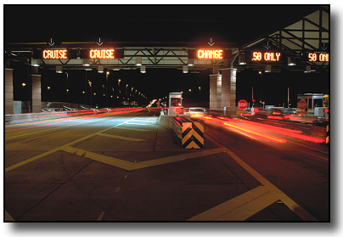
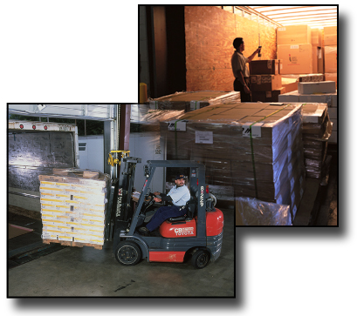
>300 MHz <1GHz
Advantages
Effective around metals
Best available frequency for
distances of >1m
Tag size smaller than 13.56 MHz
Smaller antennas
Range: licensed to 20-40' with reasonable sized tag (stamp to eraser size). Unlicensed 3-5 m.
Good non-line-of-sight communication (except for conductive, "lossy" materials)
High data rate; Large amounts
of data
Controlled read zone (through antenna directionality)

Slide 29
>300 MHz <1GHz
Disadvantages
Does not penetrate water/tissue
Regulatory issues (differences in frequency, channels, power, and duty cycle)
Regulatory issues in Europe
(similar band 869 MHz requires frequency agile chip)
950 - 956 MHz under study in Japan

Slide 30
RFID Primer…Frequencies
RFID:
Item Management
Electromagnetic
Field Coupling:
2.45 GHz
EAS
2.45 GHz

Slide 31
2.45 GHz
Advantages
Tag size smaller than inductive or
lower range UHF (1"x 1/4")
Range: greater range than
inductive w/o battery
More bandwidth than lower
range UHF (more
frequencies to hop)
Smaller antennas than lower
range UHF or inductive
High data rate

Slide 32
2.45 GHz
Advantages
Good non-line-of-sight communication
(except for conductive, "lossy" materials)
Can transmit large amounts of data more quickly than lower frequencies
Controlled read zone
(through antenna directionality)
Effective around metals with tuning/design adaptations

Slide 33
2.45 GHz
Disadvantages
More susceptible to electronic noise than lower UHF bands, e.g. 433 MHz, 860-930 MHz
Shared spectrum with other technologies--
microwave ovens, RLANS, TV devices, etc.
Requires non-interfering, "good neighbor"
tactics like FHSS
Competitive requirement: single chip--highly technical; limited number of vendors
Regulatory approvals still "in process"

Slide 34
RFID Primer…Frequency
>5.8 GHz
(European Road Telematics Frequency)
Advantages:
Less congested band/less interference
Disadvantages:
Not available in U.S. or many other countries (5.9 now in FCC review)
Must orient antennas carefully
Range limited (due to scaling issues/wavelengths)
Chip difficult to build
Expensive
RFID:
European Tolls
300 GHz

Slide 35



Spectrum Regulation
The radio frequency (RF) spectrum is a scarce and shared resource, used nationally and internationally, and subject to a wide range of regulatory oversight. In the U.S., the Federal Communications Commission is a key regulatory body that allocates spectrum use and resolves spectrum conflicts. The International Telecommunication Union (ITU) is a specialized agency of the United Nations which plays the same role internationally.

Slide 36
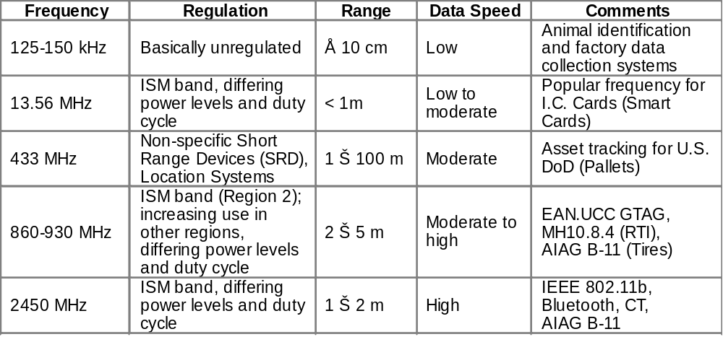
How far, how fast, how much, how many, attached to what?

Slide 37
